Slide 1
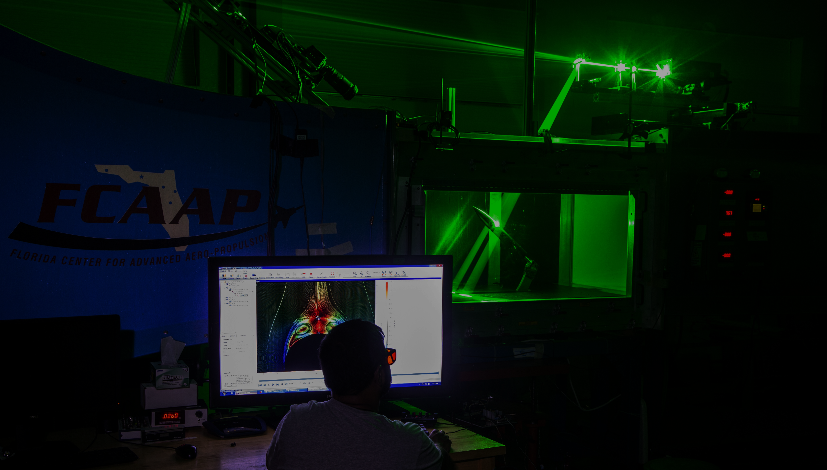
Smart Projectile
Jack Corbin | Prosley Dorcely | Emily Groth
Deepkumar Patel | Aaron Weingarten

Slide 2


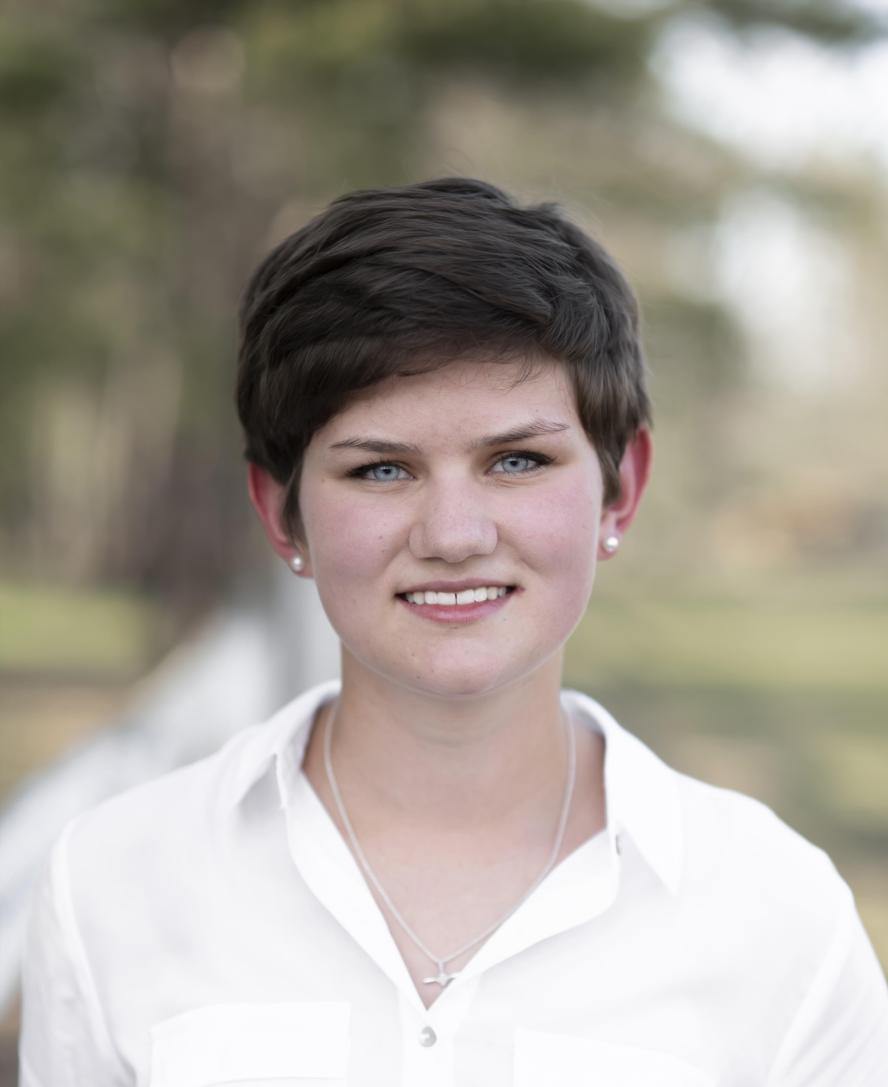


Team 509
Jack Corbin
Test Engineer
Prosley Dorcely
Research Engineer
Emily Groth
Field Engineer
Deepkumar Patel
Design Engineer
Aaron Weingarten
System Engineer
Jack Corbin

Slide 3
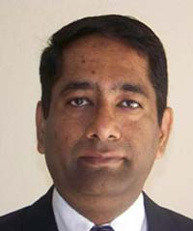
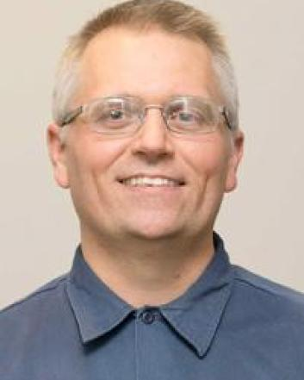
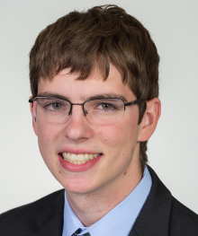
Sponsor and Advisor
Dr. Rajan Kumar
Sponsor
Dr. Jonas Gustavsson
Advisor
Robert Smith
Advisor
Jack Corbin

Slide 4
Objective
The objective of the project is to create a scale model of a projectile with an articulating nose cone and deflectable fins for subsonic wind tunnel testing.
Jack Corbin

Slide 5





Updated Customer Needs
L/D ration of 8, 12,16
Diameter of 2 inches
Nose deflection between 0 to 5 degrees with resolution ±0.1
Static or dynamic deflectable fins
Time constant optimized to less than 0.5 seconds
Suitable material and design for subsonic testing
Jack Corbin

Slide 6
Target and Metrics
System | Function | Target | Metric
Nose Actuation | Nose Deflection | ±5° | Angular Position
Nose Actuation | Nose Deflection Control | Nose Time Constant ≤ 0.5 sec | Time
Fin Actuation | Fin Deflection | ±30° | Angular Position
Fin Actuation | Fin Deflection Control | Fin Time Constant ≤ 0.5 sec | Time
Jack Corbin

Slide 7
Target and Metrics
System | Function | Target | Metric
Structure | Attach to Supports | Disassembled Supports = 0 | Number of Supports
Control | Provide Linear Output for Nose Deflection | Degrees per Voltage Step = Constant | Degrees/Volt
Jack Corbin

Slide 8
Medium Fidelity Concepts
Concept # | Concept Description
3 | An interior pulley system that deflects the nose cone to alter flight path
23 | Multi-shape fin which can be altered to allow it to find the target and change flight path
59 | Uses an internal mass for mechanical control to alter flight path
69 | Morphing fins that can widen and thin out depending on the forces they are trying to exert
83 | Thrust vectoring nozzles to articulate the nose cone to a desired deflection
Deepkumar Patel
Notes:
After performing targets and metrics, we generated 100 different concepts using multiply generation tools such as brainstorming for which with used SCAMPER to enhance our imagination, this allowed us to produce innovative ideas which resulted into more focused ideas for our project. We also used biomimicry to use nature and the world around us to generate ides. From this we selected 5 medium fidelity concepts which were ideas that we liked however not enough to solve our poject. This concepts are #3, #23, #59, #69, and #83.

Slide 9
High Fidelity Concepts
Concept # | Concept Description
27 | Smart projectile uses deflectable thrusters to change flight path
34 | Smart projectile uses articulating nose cone and dynamically deflectable fins for flight control
53 | Smart projectile rapidly ejects and retracts internal mass to change flight path
Deepkumar Patel
Notes:
After that we selected 3 high fidelity concepts which contained ideas that our team was most intetrested in to solve our project. We believe that this concept embody our project scope and would provide us with best result for the project. This are #27, #34, and #53.

Slide 10
Concept Selection
Final Rating Comparison
Selection Criteria | Design #3: | Design #34: | Design #83:
Controls Nose Deflection | 0.287 | 0.574 | 0.140
Takes User Input | 0.333 | 0.333 | 0.333
Provides Output for Fins | 0.096 | 0.674 | 0.230
Secures Components | 0.143 | 0.429 | 0.429
Deepkumar Patel
Notes:
After selection our medium and high fidelity concepts we performed a multi-stage analytical procedure to narrow down the number of possibilities before we choose the final concept for our design. By performing the Binary pairwise comparison, house of quality and pugh chart we reduces the number of potential design to more manageble number. From which we recuded to our top 3 ideas which are #3, #34, and #83. After that we perfomed analytical hierarchy processs reduce bais in our concept selection. We compared our top three ideas for each function, with this we arrive to our final rating comparison for each criteria as shown in the table the design #34 was the best overall.

Slide 11
Concept Selection
Concept | Alternative Value
Smart projectile has an interior pulley system that deflects the nose cone to alter flight path | 0.258482
Smart projectile uses articulating nose cone and dynamically deflectable fins for flight control | 0.47494
Smart projectile uses thrust vectoring nozzles to articulate the nose cone to a desired deflection | 0.266536
Deepkumar Patel
Notes:
throught this process, we determined that the best design for our project was the #34 Smart projectile that uses articulating nose and dynamically deflectable fins for flight control

Slide 12
Updated Functional Decomposition
Nose Actuation
Control
Structure
Fin
Actuation
Deepkumar Patel
Notes:
We updated our functional decomposition to add fin actuation as one of the primary goal for the project.

Slide 13

Updated Functional Decomposition
Fin Actuation
Mechanical
Holds position
Deflection
Deepkumar Patel
Notes:
Fin actuation is going have 2 mechanical systems which are going to control the deflection and hold position after the fin has arrived to this position.

Slide 14
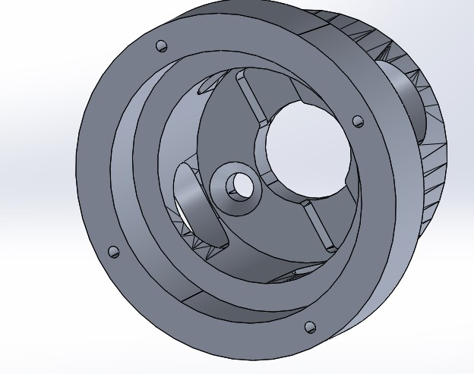
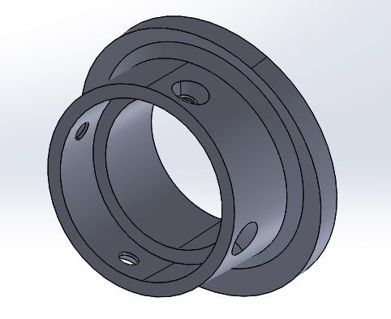
Part Modifications
Frontal and Rear Deflecting Surfaces:
Move the total angular displacement from 20 to 5 degrees
Will reduce friction
Improves non-linearities in nose motion
Front deflecting surface
Rear deflecting surface
Prosley Dorcely

Slide 15
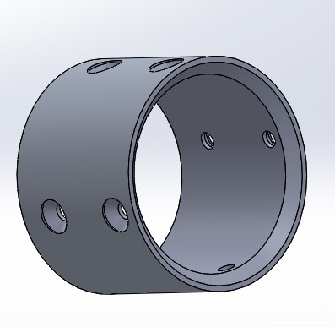
Part Modifications
Frontal Outer Body:
push the outer casing back or in to allow
for the skin to take up a greater length
goal of 2 diameters of skin
Prosley Dorcely

Slide 16
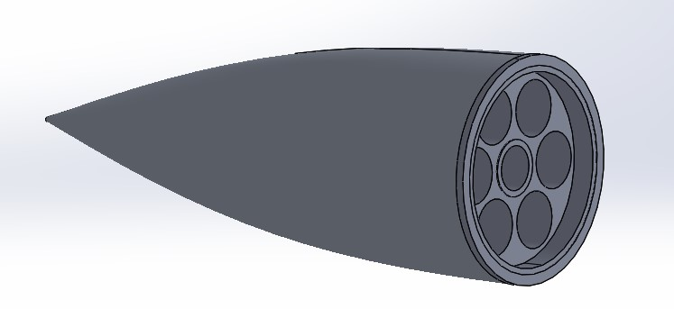
Part Modifications
Nose Cone Light Weighting:
Reduces sagging
Reduces load on motors allowing for an increase in test time
Aluminum sintering
Structurally stable
Good surface finish
Expensive (approx. $1000 quote from Xometry)
Prosley Dorcely

Slide 17
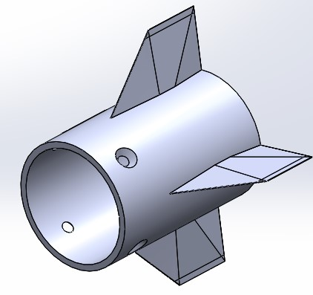
Fin Deflection
Our idea is to use four stepper motor to control the fins
Only issue is space in the rear portion of the model
Small stepper motors lack resolution
Prosley Dorcely

Slide 18
Next Steps
Identify what parts can be used for the new model
Create CAD for fin deflection design
Purchase or re-machine parts that can not be salvaged
Prosley Dorcely

Slide 19
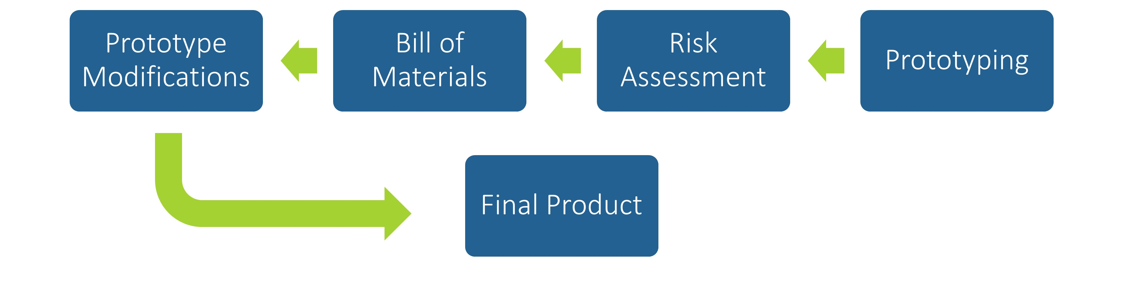
Future Work
Prosley Dorcely

Slide 20
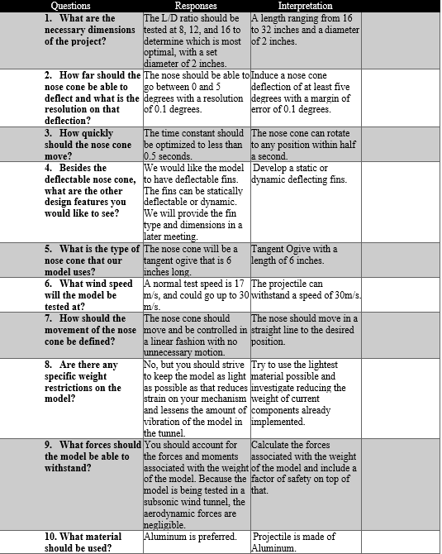
Customer Needs Backup

Slide 21
Markets Backup
Primary Market
  FCAAP (Florida Center for Advanced Aero Propulsion)
Secondary Markets
  Air Force Office of Scientific Research (AFOSR)
  Air Force Research Laboratory (AFRL)
  Lockheed Martin
  General Dynamics
  Raytheon Technologies
  Boeing
  Northrop Grumman

Slide 22
Stakeholders Backup
Florida Center for Advanced Aero Propulsion
FAMU-FSU College of Engineering
Dr. Rajan Kumar
Dr. Jonas Gustavsson
Dr. Shayne McConomy
Dr. Suvranu De

Slide 23
Standard Shapes
Summary Box
Text box 1
Outlined Text Box

Slide 24




Approved Logos

Slide 25
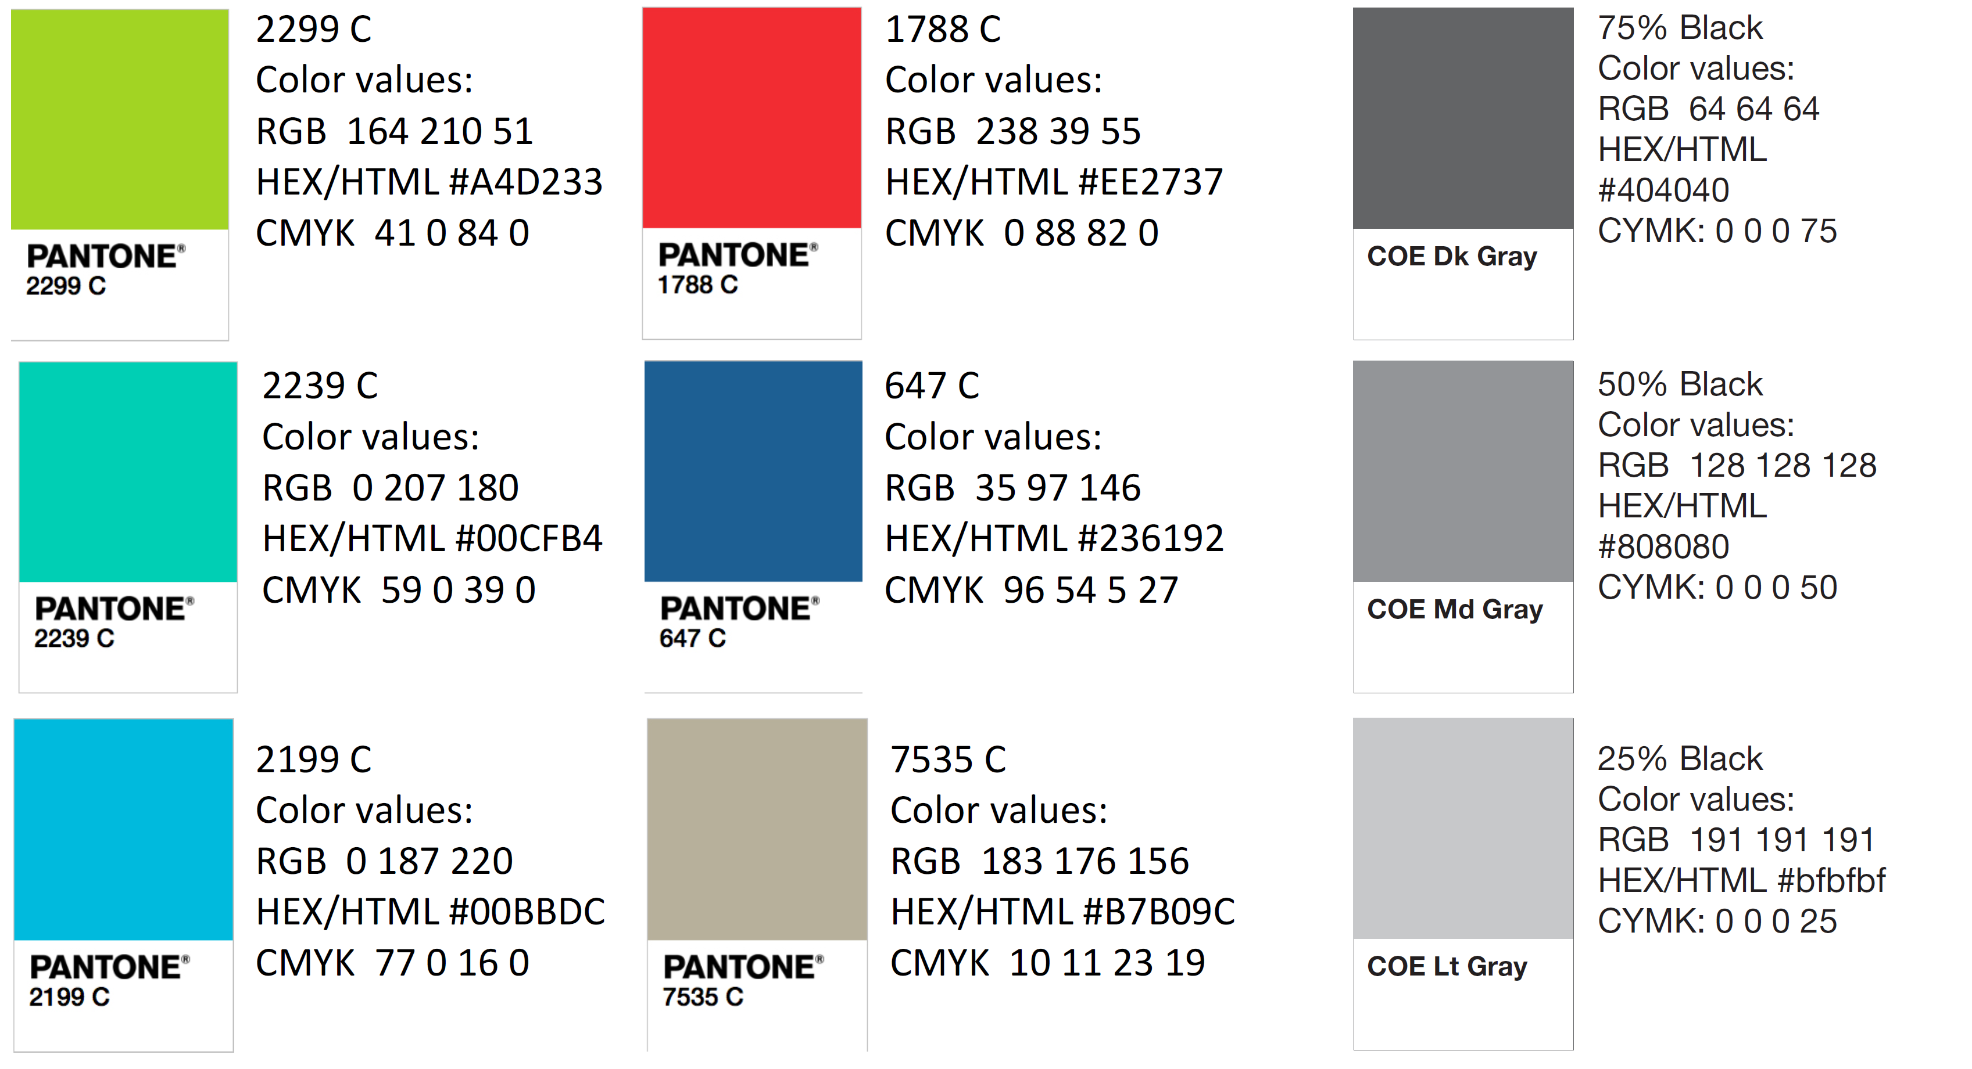
Color Palette

Slide 26
APA Tables
Category 1 | Category 2 | Category 3 | Category 4 | Category 5
Item 1
Item 2
Item 3
Item 4
 | Category 2 |  |  | Category 3
Category 1 | subcategory 1 | subcategory 2 |  | subcategory 1 | subcategory 2
Item 1
Item 2
Item 3
Item 4

